Slide 1
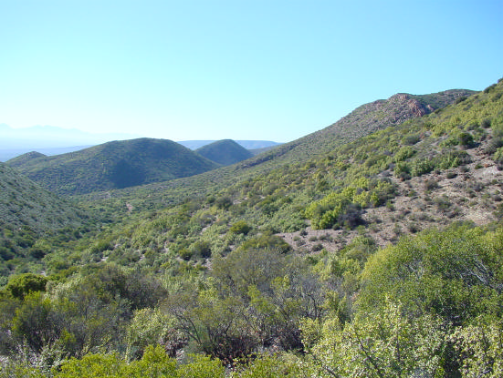
Very High Resolution Remote Sensing of Carbon Stocks in Subtropical Thicket
Dugal Harris¹
Adriaan Van Niekerk²
Jan Vlok³
Mike Powell⁴
Department of Geography & Environmental Studies, Stellenbosch University
Centre for Geographical Analysis, Stellenbosch University
Research Associate, Nelson Mandela Metropolitan University
Department of Environmental Science, Rhodes University

Slide 2

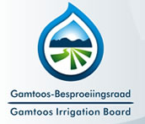



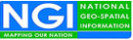
With thanks to
Gamtoos Irrigation Board via the Working for Water Programme for the Department of Environmental Affairs
National Research Foundation

Slide 3
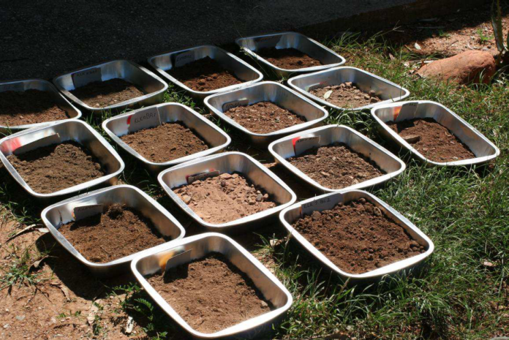
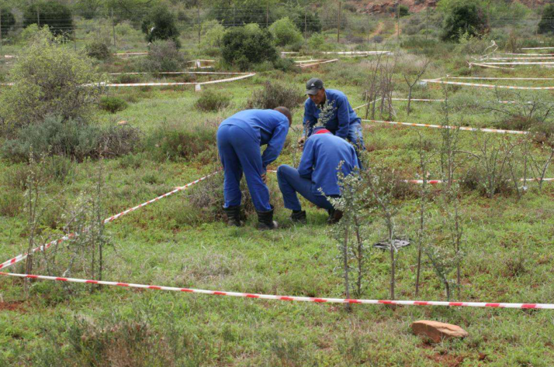
Background
Large areas of Spekboom habitat have been degraded. Restoration of this habitat is beneficial from a number of perspectives.
Spekboom canopy cover and carbon stock maps are required to assist in planning and monitoring of restoration activity.
Map scales of at least 1:10000 scale are required for farm level restoration planning.
Source: (Powell 2009)

Slide 4
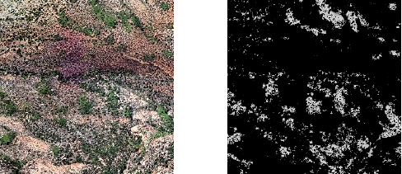
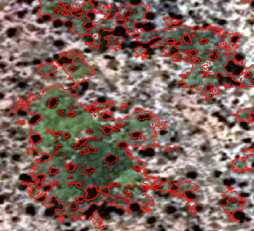
Aim
Develop an automated or semi-automated remote sensing technique to accurately estimate Spekboom canopy cover and total above-ground carbon (TAGC) in Subtropical Thicket, over large areas.

Slide 5
Objectives
Conduct a literature review.
Perform a field study to establish canopy cover reference sites and ground truth.
Source and rectify VHR imagery of the study area. Develop a technique for radiometric correction of the imagery.
Design a Spekboom canopy cover mapping algorithm. Apply the algorithm to imagery of the study area and interpret and evaluate the results.
Acquire and calibrate imagery of the Baviaanskloof study area.
Conduct a second field study to accurately locate the Baviaanskloof carbon stock ground truth plots in the imagery and establish further canopy cover ground truth.
Using the available BNR carbon stock ground truth, develop a regression technique to determine TAGC from the VHR imagery.
Evaluate and interpret the carbon stock results.

Slide 6
Rationale
Apart from the benefits to restoration planning and monitoring, a number of aspects of this research are interesting from a remote sensing perspective:
Carbon stock estimation techniques are important in the context of climate change.
Use of VHR imagery for environmental monitoring of large areas is uncommon.
Arid regions present some remote sensing challenges not typically encountered in forests.

Slide 7
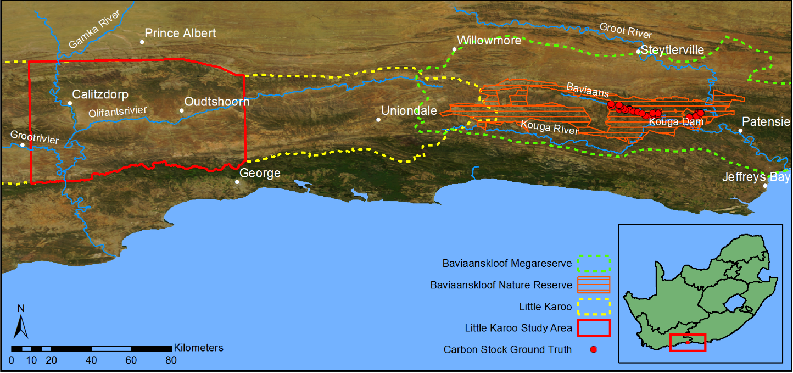
Study Area
Subtropical thicket makes up 35% of the Little Karoo of which roughly 90% is degraded to some extent (Vlok, Cowling & Wolf 2005).
The BNR consists of 19 000 ha of Subtropical Thicket of which 95% is degraded (Powell 2009).
Detailed carbon stock ground truth from Powell (2009).

Slide 8
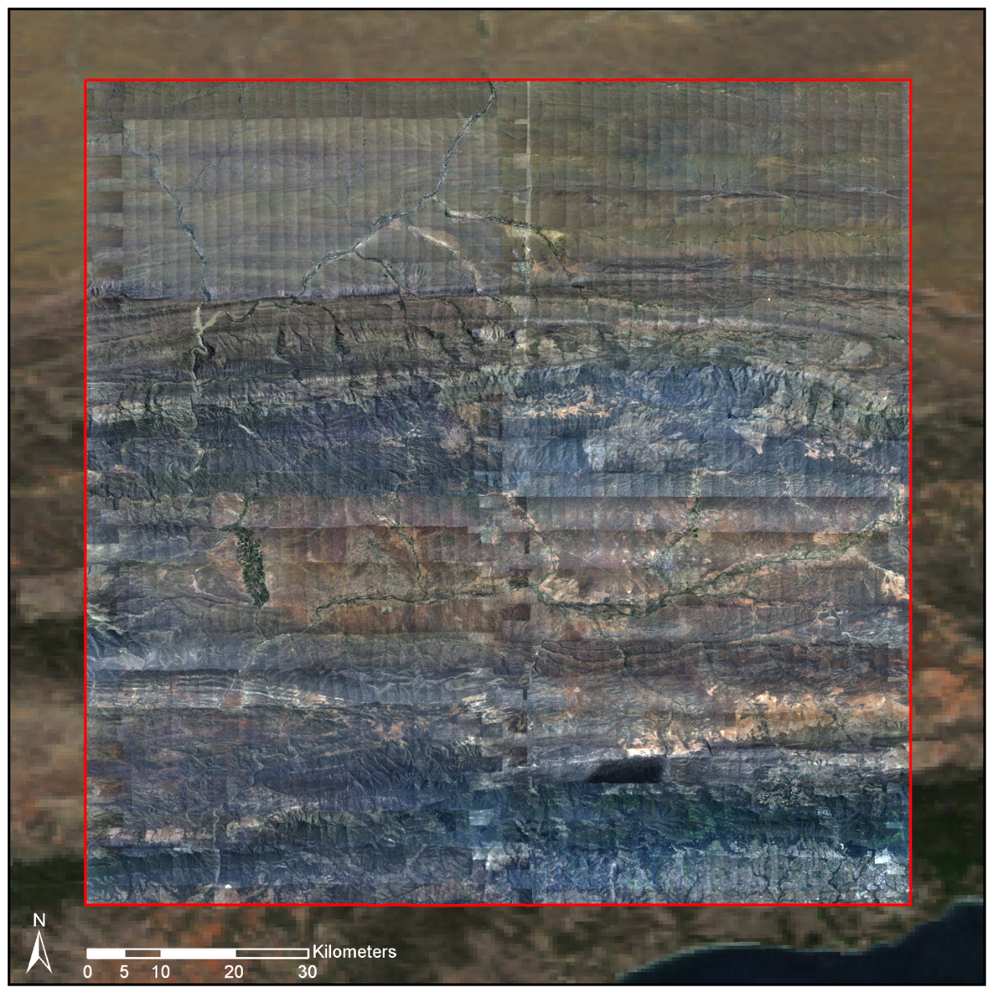
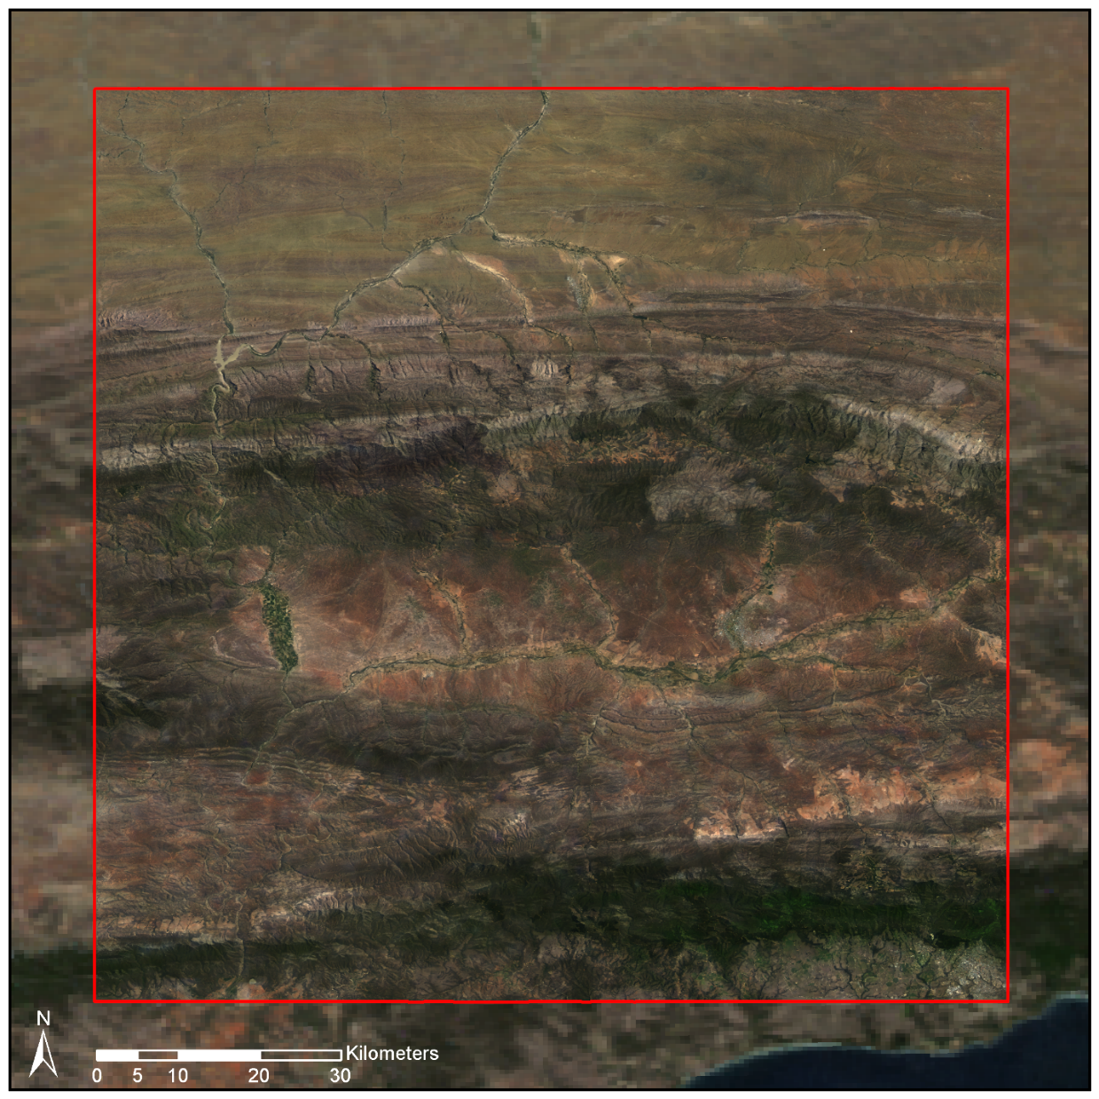
Completed Work: Image Calibration
Radiometrically and geometrically corrected imagery is required for quantitative remote sensing.
A straightforward technique to fuse coarse resolution satellite images with fine resolution aerial imagery was developed.
Raw aerial image mosaic
Corrected mosaic

Slide 9
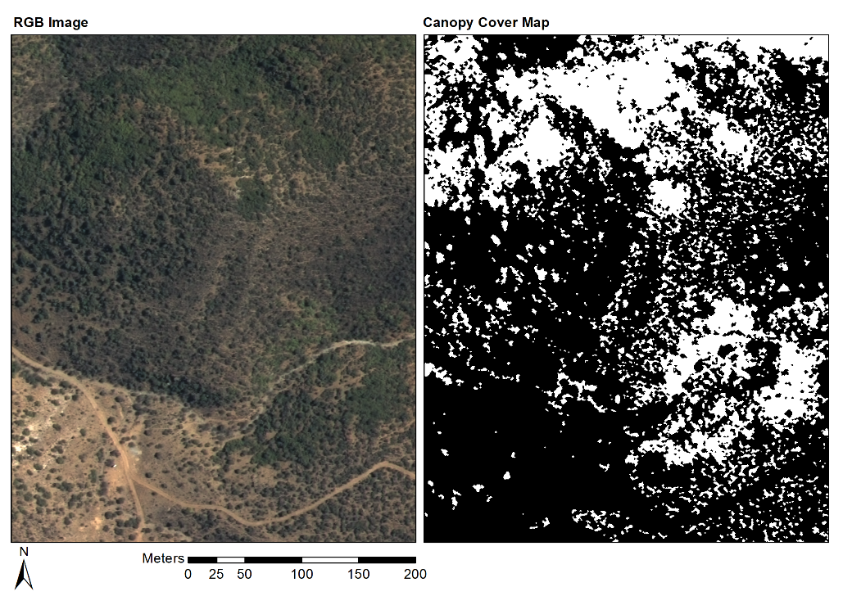
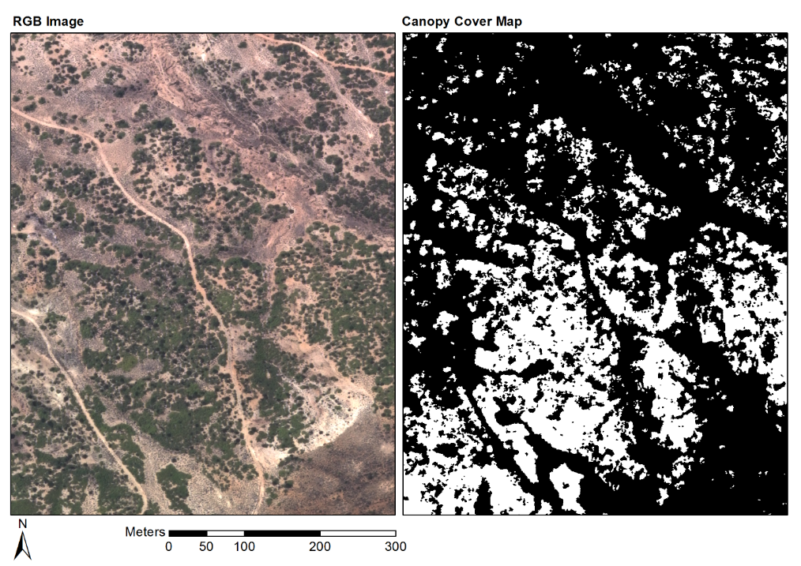
Completed Work: Canopy Cover Classification
A Spekboom canopy cover classifier was developed and applied to imagery of the study area.
A mean absolute canopy cover error of 6% was obtained over 20 ground truth sites.
Good overall performance although some sites were problematic.

Slide 10
Contribution
Carbon stock measurements are typically performed with field allometry which is time-consuming, costly and not practical on a large scale.
The impracticality of allometry is confounded in Subtropical Thicket due to its density, heterogeneity and complex growth forms (Powell 2009).
The main contribution of the research lies in the potential of automating carbon stock measurements which would provide significant time and cost savings over manual methods.
If this was successfully achieved, it would ease the cost, time and administrative burden of qualifying for carbon trading schemes such as VCS and CDM.
It could also be used in the formulation of a simplified monitoring methodology for the local context.
Successful canopy cover and carbon stock mapping algorithms would be useful in deepening understanding of thicket ecology and restoration dynamics.

